Slide 1

Day on the Hill
March 20, 2024

Slide 2

Reena Context
Total Housing Resources, accessed and used
Children's Group Homes – 2
Group Homes – Under 1:1 ratio 12
Complex care homes - 1:1 or more 18
Dedicated seniors homes – 2
Multiplexes triplex, sixplex, … 8
Community apartment units - TCHC, Kehilla, markey… 84
Condo Units - 8
Intentional Buildings - 2: SKRR, LFRR 3rd in development

Slide 3
Major Directions
Develop, Build and Manage
    Tansley Complex care home
    Frankfort Family intentional residence
Sustainability – GReena
    Solar Planning and other environmental
    Unfunded Repair and maintenance – not lose asset

Slide 4
Tansley
7 residents on 4 floors
2 fully accessible units, elevator
$5.4 million over 4 years to develop

Slide 5
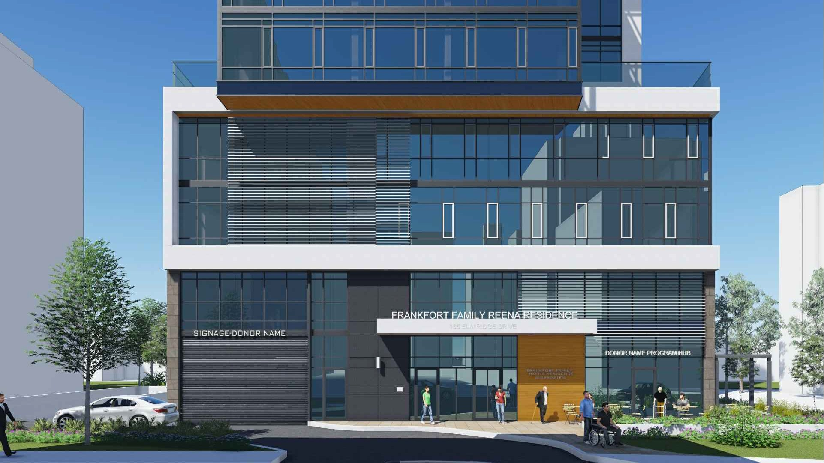
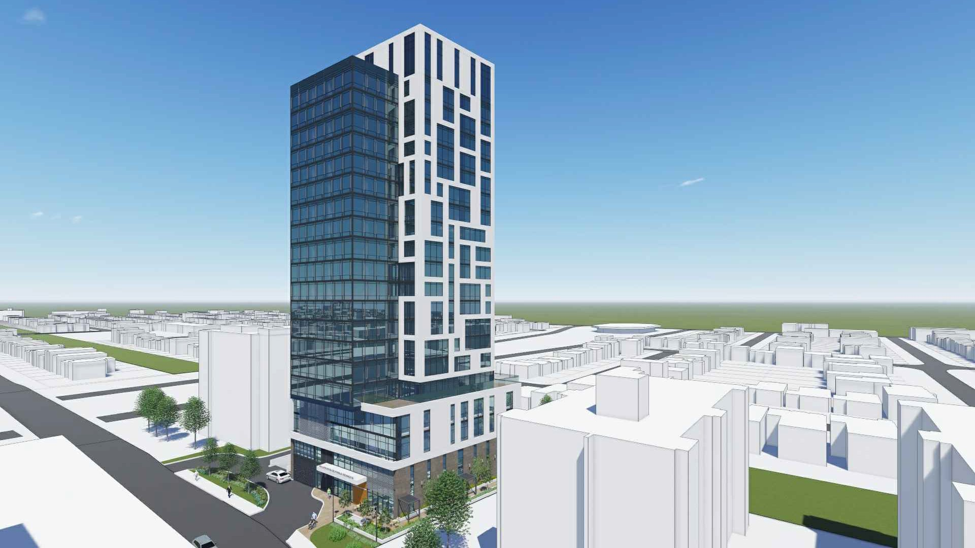
Frankfort Family
Reena Residence
111 units = 168 Tenants
5 service providers = diverse complimentary supports
100% supportive universal access units /
21 % fully accessible
$88 million, 6 years from start to projected completion
Notes:
New builds – In line with CMHC co investment As much as 20% higher cost both soft and hard costs with Housing affordability targets that are between 50% of market and 20% - or 80-% AMR to under 50% AMR ie ODSP rates
Frankfort
Tansley

Slide 6

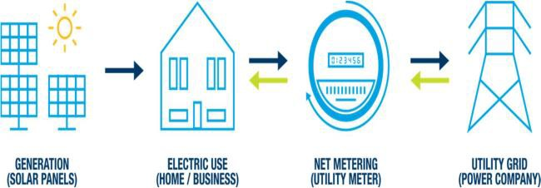

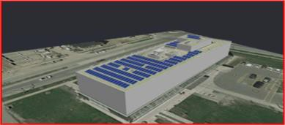
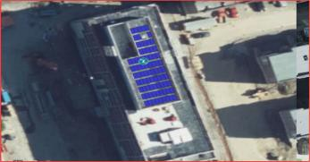
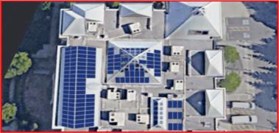
Renewable Energy
Existing Buildings - New Solar
 |  | Reena Overall | RCR | LFRR | Battle Centre
System Details | Estimated Usage (kWh) | 535,000 | 110,000 | 50,000 | 60,000
 | PV Generation (kWh) | 488,834 | 100,670 | 49,070 | 56,090
 | PV System Size (kWdc) | 424.35 | 85.05 | 41.85 | 54.45
Pricing & Cost | Install Cost | $1,174,645 | $206,354 | $116,375 | $138, 740
 | Estimated Hydro Fees | $37,000 | $6,200 | $6,200 | $6,200
 | Total Cost | $1,218,645 | $212,554 | $144,940 | $144,940
Payback Period | Simple Payback (Years) | 13.88 Years | 11.65 Years | 13.36 Years | 13.73 Years
Discount Improves Payback | 0% Hydro Rate increase | $506,056 Discount → 9.82 Years | $65,000 Discount → 9.99 Years | $51,000 Discount → 9.94 Years | $63,000 Discount → 9.96 Years
 | 4% Hydro Rate increase | $375,750 Discount → 9.85 Years | $39,000 Discount → 9.83 Years | $37,000 Discount → 9.93 Years | $47,000 Discount → 9.94 Years
Net metering is a regulation, (O.Reg 541/05) under the Ontario Energy Board Act, 1998 and is available throughout Ontario
Notes:
Improvements and maintenance – We should be able to access at least 20% of the supportive housing maintenance investments but we are often excluded
Greena – solar plus – Business can get credits, we can’t
Repairs and maintenance Programs and application – Province to City , cities rarely fund sector repairs

Slide 7
Unfunded Repairs
PFR funding – $87,000 on over $1,000,0000 in priority projects
No social service relief funds
No CMHC repair and renewal $

Slide 8
CMHC Annual Progress Report
National Housing Co-Investment Fund:
Of the 31,589 new units CMHC has committed to support,
People with DD were defined as one of the priority groups, and the development of 2,075 new units has been committed.
Commitment to date 847 units for people with developmental disabilities. 1/3 complete
National Housing Strategy:
CMHC funding commitment for repair renewal social housing.
National Target 240,000
To date 129,000 approved, 118,000 affordable, 43,000 complete.
In Ontario 20% of all supportive housing is DS. The bilateral agreement has no DS targets

Slide 9
Questions?

