Slide 1


Slide 2

Intentional Community Consortium
Finding solutions to the affordable housing crisis faced by individuals with developmental disabilities, focusing on housing, support services and community engagement

Slide 3
Agenda
10:00 a.m. | Press Conference
9:00 a.m. | ICC Introduction and Update | Gary Gladstone
9:20 a.m. | CMHC – Jeremy Tessier, Specialist, Knowledge Transfer, Outreach | Gary Gladstone
9:50 a.m. | Reena Presentation | Bryan Keshen
10:05 a.m. | Karis Developmental Services Presentation | David Petkau
10:20 a.m. | Bonita Zarrillo, MP, NDP Critic for Infrastructure and Communities; Disability Inclusion and Deputy Health Critic | Patricia Franks
10:40 a.m. | Greetings from OASIS | Dr. Claudine Cousins, Vice-Chair
10:55 a.m. | Greetings from Provincial Network on Developmental Services | Michelle Brooks, Chair
11:10 a.m. | Mike Morrice, MP, Green Party | David Petkau
11:25 a.m. | Community Living Toronto Presentation | Brad Saunders
11:40 a.m. | KW Habilitation Presentation | Ann Bilodeau
11:55 a.m.. | Lunch
12:10 p.m. | Canadian Centre for Caregiving Excellence Presentation | James Janeiro
12:25 p.m. | Scott Aitchison, MP, Conservative Shadow Minister for Housing and Diversity and Inclusion | Ann Bilodeau
12:45 p.m. | Chris Bittle, MP, Liberal Parliamentary Secretary to the Minister of Housing, Infrastructure and Communities | Lino Fera
1:05 p.m. | Open Discussion & Wrap Up | Gary Gladstone
1:45 p.m. | Leave for Question Period

Slide 4


Intentional Community Consortium
Founded in 2017
Registered not-for-profit, 2022
Representing charities and not-for-profit organizations, working to solve the housing crisis for those with diverse abilities across Canada

Slide 5
Intentional Community Consortium
Mission
Affect change by applying shared learning and networking from our member organizations to:
  Expand affordable housing projects for mixed use.
  Combine the strength of our member organizations to create hundreds of housing units throughout Canada with a preference for multi-unit projects of 20-units or more.
  Advocate as a consortium to all levels of government.
  Share tools and information through partnerships and member engagement.

Slide 6
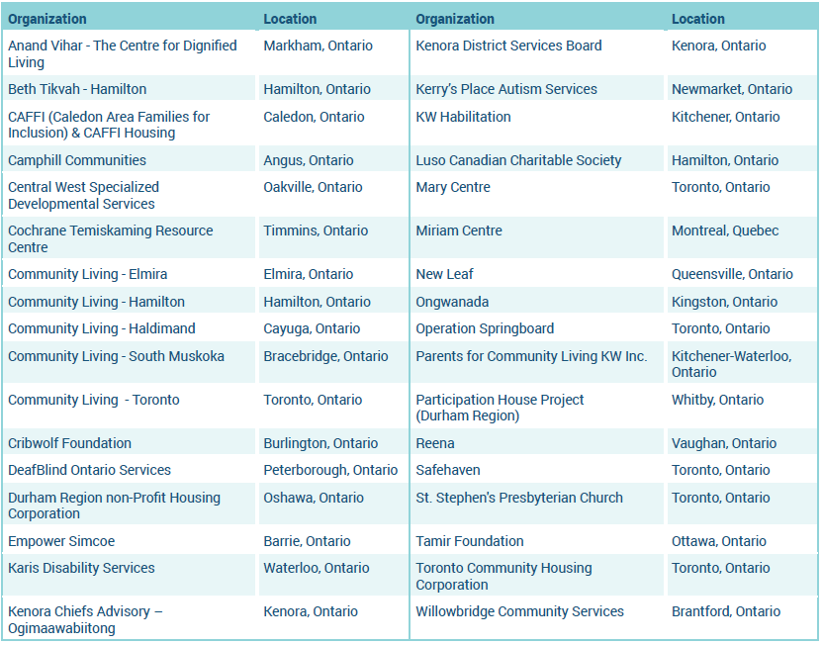
Our Member Organizations

Slide 7
Officers
Name | Title | Organization
Gary Gladstone | Chair | Reena
David Petkau | Vice-Chair | Christian Horizons
Patricia Franks | Secretary / Treasurer | CAFFI
Ann Bilodeau | Director at Large | KW Habilitation
Lino A. Fera | Director at Large | Cribwolf Foundation

Slide 8
Federal Ask
Housing as a human right – Canada signatory to UN Convention on the Rights of Persons with Disabilities
Federal investments through co-investment fund reflect updated costs as inflation, financing, and other market forces add costs particularly for deeply affordable supportive housing development.
Establish a dedicated pathway for deeply affordable and supportive housing like ICC, that will generate secondary benefits to the community including reduced health costs, and related social and policing supports.

Slide 9
Provincial Ask
Provincial investment in housing for individuals with developmental disabilities by earmarking 10% of the National Housing Strategy funding to this critical need, and requiring municipalities to commit accordingly.
Partner with local agencies serving those with developmental disabilities to quickly build more housing.

Slide 10
Municipal Ask
Establish an equitable assignment of land, funds, and resources for affordable, accessible and supportive housing for individuals with developmental disabilities.
Ensure favorable zoning to allow for more inclusive communities providing affordable, accessible and supportive housing.

Slide 11
Points to Ponder
How will your party support not-for-profit organizations to get into the housing market and provide deeply affordable housing, without significant capital?
How would your party ensure that affordable housing funding for individuals with diverse abilities is used for its intended purpose by Provincial governments?
Are there policies and protections in place to ensure continuity of support for affordable housing funding long term, even if the ruling government party changes in the future?
Will your party consider bulk financing at the front end over flatlining any funding over a long period of time to urgently create and complete supportive housing spaces?
How would your party ensure that affordable housing for people with diverse abilities is attainable on the provincial housing subsidy they receive?

Slide 12
Points to Ponder
When will CMHC change their rules to allow for creative partnerships and joint ownership, such as condominium corporations, in affordable housing projects?
Will your party support using Registered Disability Savings Plans funds for down payments on housing?
Will your party fund a sector-led incubator and system development entity like the ICC?
Will there be investment in strengthening supplements, grants, and new supportive funding for deeply affordable housing accessible to people with diverse abilities?

Slide 13


Jeremy Tessier
Specialist, Knowledge Transfer, Outreach
Moderated by Gary Gladstone, Reena, Chair ICC

Slide 14
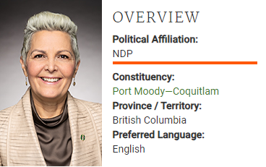
Bonita Zarrillo, MP
NDP Critic for Infrastructure and Communities; Disability Inclusion and Deputy Health Critic
    Moderated by Patricia Franks, CAFFI, Secretary / Treasurer ICC

Slide 15
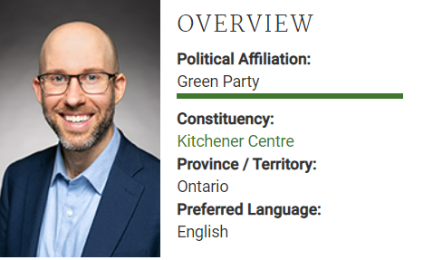
Mike Morrice, MP
Green Party MP
    Moderated by David Petkau, Karis Developmental Services, Vice-Chair ICC

Slide 16
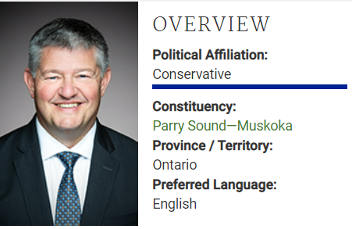
Scott Aitchison, MP
Conservative Shadow Minister for Housing and Diversity and Inclusion
    Moderated by Ann Bilodeau, KW Habilitation, Director ICC

Slide 17
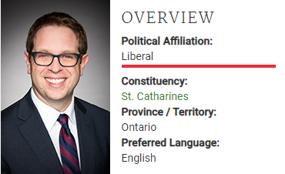
Chris Bittle, MP
Liberal Parliamentary Secretary to the Minister of Housing, Infrastructure and Communities
Moderated by Lino A. Fera, Cribwolf Foundation, Director ICC

