Slide 1

Karis Disability Services
(Formerly Christian Horizons)
David Petkau, Director of Community Engagment, Executive Director (South District)
dpetkau@karis.org

Slide 2
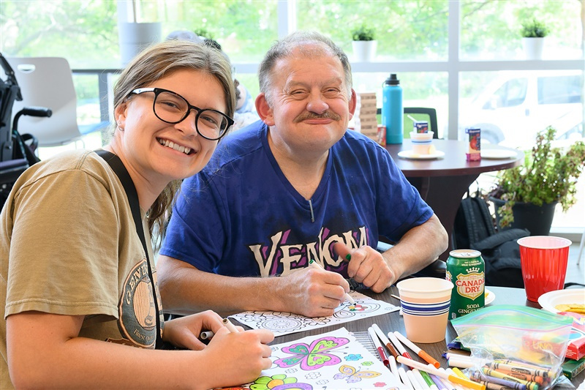
An Affordable Housing Journey
Not all affordable housing projects have a happy ending!

Slide 3
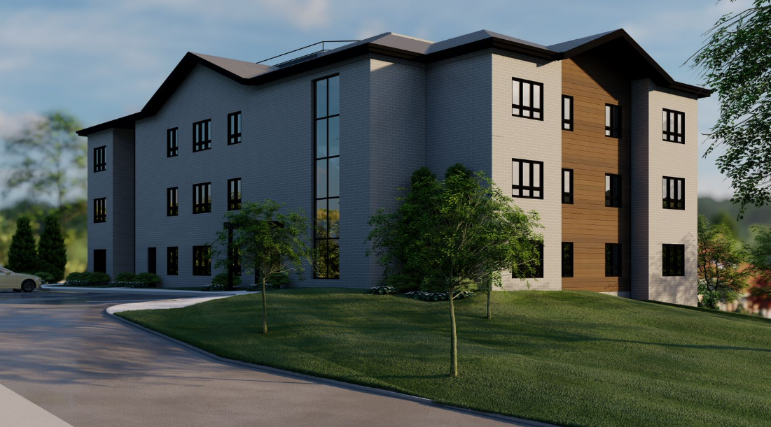
The Vision
Niagara area, 20 Units, Mix tenancy including people with a developmental disability (depending on the CMHC stream), Deeply Affordable, ‘Care Occupancy’ capable. Zoning Variances completed.

Slide 4

What did the system ask of us?
Be invested: Have skin in the game!
* Capital funds – sold another property and invested
* Committed internal resources
* Developed a capital fundraising campaign
* Our Charitable Foundation was on board

Slide 5
What did the system ask of us?
Partner with others
* Major Corporate Donor – the land
* Donors in general
* MCCSS – Provincial level funding- Developmental Services
* The City – Development, zoning, fees etc..
* The Municipality: Development charges, Rent subsidies
* The Community – i.e. Town Hall meetings

Slide 6
What did the system ask of us?
CMCH Applications, Contributions
* Seed Funding- Successful
* Rapid Housing Initiative Round 1 – unsuccessful
* Rapid Housing Initiative Round 2- unsuccessful
* Co-investment fund – Successful! Grant & Loan

Slide 7
What did the system ask of us?
Progress, Commitment
* Housing Consultant, Architect
* Construction Management agreement
* Design / Innovation – B3 capable, accessible, community space,
energy efficient, Steel wall panel construction.
* Cost Consultants D, C, B, A
* Public Tender

Slide 8
What happened?
Tenders, Cost Increases!
* The Pandemic
* Cost came in much higher than expected
* CMHC had no mechanism to adapt
* Donor plan was at max
* MCCSS funding was fiscal based
* Decision Point: RHI #3?
- this would mean pulling our previous relationship
- return at a much lower ‘per door’ co-investment fund commitment

Slide 9
The Result
Up to 20 units lost from the affordable housing inventory of our community, No purpose-built rentals in the last 25+ years.
An innovative design that could bridge a little-known gap was lost (people that can’t enter into their own lease agreement, need assistance to evacuate)
Partners redirecting their interests and passions
Investment lost

Slide 10
The Learning
More resources committed
Ability for the system to adapt and be flexible
More collaboration between levels of government
Seed funding – insufficient, there is a lot of upfront investment.
Fill the housing gap for those that do not engage their own homes and have needs that impact their ability to evacuate (B3)

Slide 11
An Affordable Housing Journey
Not all affordable housing projects have a happy ending!

